Slide 1
Ensuring UDP reliability
Session 06
Course : COMP6584001 – Network and Systems Programming
Ivan Sebastian Edbert

Slide 2
Learning Objectives
At the end of this session, the student will be expected to :
Understand about Reliable File Transfers Using TFTP
Able to Handle TFTP Servers

Slide 3
Outline
TFTP Types
TFTP Server

Slide 4
TFTP Types

Slide 5
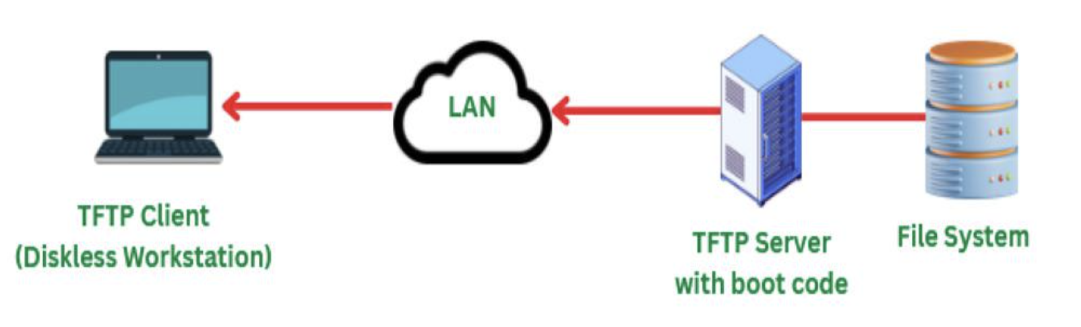
Trivial File Transfer Protocol (TFTP)
TFTP, or Trivial File Transfer Protocol, is a simple and lightweight protocol used for transferring files over a network.
It is designed to be minimalistic and is commonly employed in situations where a more feature-rich protocol like FTP (File Transfer Protocol) might be unnecessary or too complex. TFTP operates at the transport layer of the Internet Protocol (IP) suite.

Slide 6
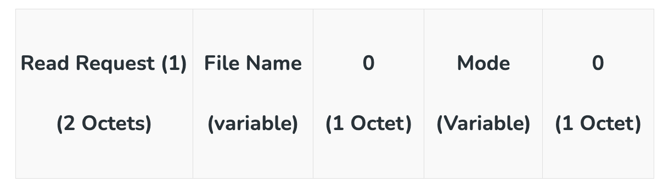
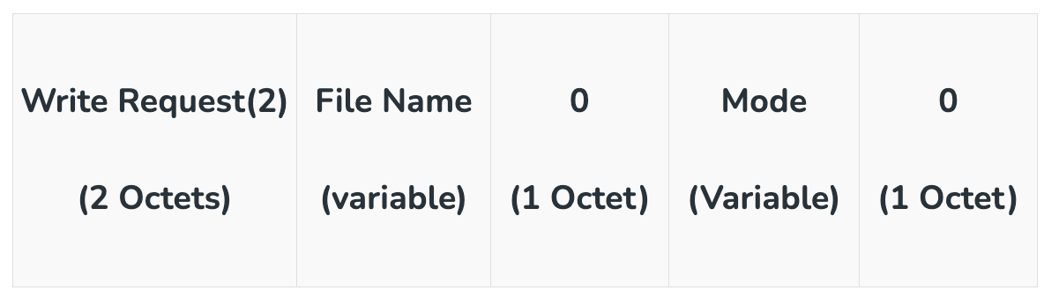
TFTP Types
4 types of tftp
Read Request
→ Read Request is also known as Type 1. A read request is used by the client to get a copy of a file from the server. Below is the format of the Read Request
Write Request
→ Write Request is also known as Type 2. Write Request is being used by the client for writing a file into the server. Below is the format of the Write Request.

Slide 7
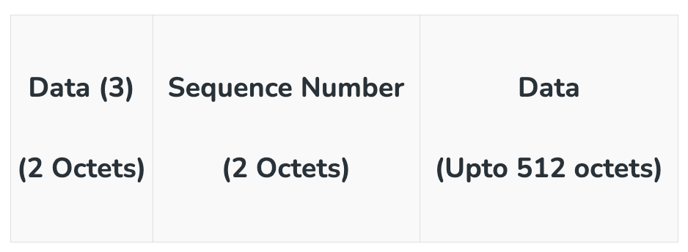
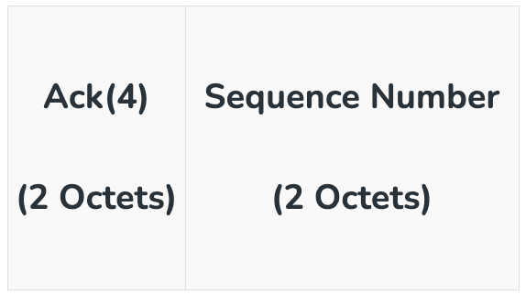
TFTP Types
4 types of tftp
Data
→ Data is also known as Type 3. Data consists of a portion of a file that is being copied. The data block is of fixed size that is 512 octets. Below is the format of the Data.
Acknowledgement
→ Acknowledgment is also known as Type 4. The data present at the last in the message consists of the End of File(EOF) where the size is less than 512 octets. This acknowledgment is used by both client and server for acknowledging the received data.

Slide 8
tftp
working
TFTP makes use of port number 69 as it uses User Datagram Protocol (UDP).
When the connection is established successfully between client and server, the client makes a Read Request (RRQ) or
Write Request( WRQ). If a client wants to only read the file it requests RRQ and if the client wants to write some data into a server then it requests for WRQ.
Once the connection is established and a request is made communication of files takes place in the form of small packets. These packets are 512 bytes each.
The server then communicates the packet back to the client and waits until it receives an acknowledgment from the client that the packet has been received.
When the acknowledgment is received from the client side, the server again sends the next packet which is 512 bytes each.
The same steps as mentioned above continue until the last packet is sent by the server to the client.

Slide 9
tftp
Advantages vs disadvantages
Advantages:
TFTP Protocol makes use of User Datagram Protocol (UDP).
TFTP requires less amount of memory.
TFTP is simple to implement.
TFTP is supported by many network devices such as routers, firewalls, and switches.
TFTP has low overhead as compared to other protocols and therefore can be used for low-bandwidth networks.
TFTP can transfer small files such as boot files, and firmware images more fastly.
Disadvantages:
TFTP does not provide any security features
TFTP does not provide any approach for error checking.
TFTP can be used for limited functionalities only.
TFTP servers do not allow the renaming and deletion of files.

Slide 10
TFTP server

Slide 11
Tftp server
TFTP servers are commonly used in various scenarios, such as network booting, firmware upgrades, and configuration file transfers.
Linux is far and away the most common operating system on the type of devices where you’re likely to encounter a TFTP server. But, there is also a rich ecosystem of Windows and macOS devices that run device firmware (think Apple TVs and Microsoft Surface for a few examples).
Example of TFTP Server that can be used:
SolarWinds TFTP Server
Windows TFTP Utility
TFTPD64
haneWIN TFTP server
Pinkie

Slide 12
TFTP
Solarwinds tftp server
The TFTP Server software offered by SolarWinds is a 100% free version that runs on Windows only. It is not an expiring trial. It offers basic functionality such as IP-range lockdown and can transfer files up to 4GB in size. It runs as a Windows service which makes it easier to manage with native Windows tools.
Key Features:
Suitable for transferring device configuration images
Files up to 4 GB
Concurrent transfers
Communicates with several devices simultaneously
Free TFTP server for Windows
→ SolarWinds TFTP server is a lightweight file transfer utility, which is exactly what a TFTP server should be. This tool is a fuss-free solution and it is free to use. The program runs on Windows and Windows Server and it can be used to manage the movement of files of u to 4 GB in size, which is large for a TFTP system.

Slide 13
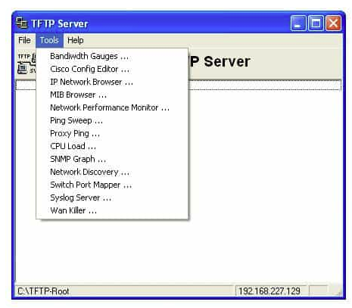
solarwinds
Pros & cons
Pros:
Completely free
Simple interface, no clutter, fluff, or advertisements
Available as a Windows service, allowing tasks to be scheduled
Can authorize single IP addresses, or an entire range
Lightweight install – uses minimal resources
Cons:
Like all TFTP servers, you will still need technical experience to set the service up properly

Slide 14
tftp
Windows tftp utility
The Windows TFTP Utility is a bare-bones TFTP server for Windows systems. It is extremely small and has almost no configuration options. On the one hand, that allows the utility to be very small and fast. On the other hand, it means that you’re unable to specify some basic configuration such as which network interface to bind.
Key Features:
Basic TFTP
Windows only
Lightweight
Small footprint
Free to use
→ Windows TFTP Utility is a free utility for Windows, but its name is a little confusing. To be clear, this isn’t a Microsoft product and it isn’t part of Windows. Rather, it is a third-party enthusiast-developed tool that can be installed on Windows. The big advantage of this tool is that it is very basic, which is what most people want from a TFTP server.

Slide 15
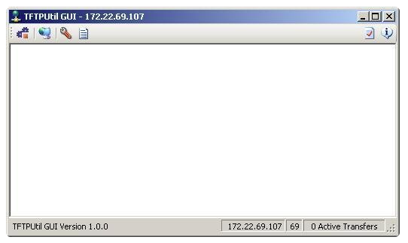
Tftp utility
Pros & cons
Pros:
Free to use
Uses very few resources
Better for more infrequent use
Cons:
Lacks configuration options, less ideal for more in-depth TFTP services
Not the best fit for larger companies that are looking to use TFTP on a more long term basis

Slide 16
tftp
TFTPD64
Tftpd64 is a free TFTP server for Windows. The utility also includes a TFTP client, a DNS server, a DHCP server, and a Syslog server. There is also a SNTP receiver in the package to coordinate with the Simple Network Time Protocol.Key Features:
Widely used
DHCP, DNS, SNTP, and Syslog servers included
Free to use
→ TFTPD64 is a package of utilities that includes a TFTP client and a TFTP server. You also get a DHCP server and log management functions in this handy free tool.
It is not only a sleek TFTP server but also bolts on some other features. The list of additional features includes a DHCP server, a DNS server, SNTP (time) server, and a Syslog server, so it will help you manage your IP addresses as well.

Slide 17
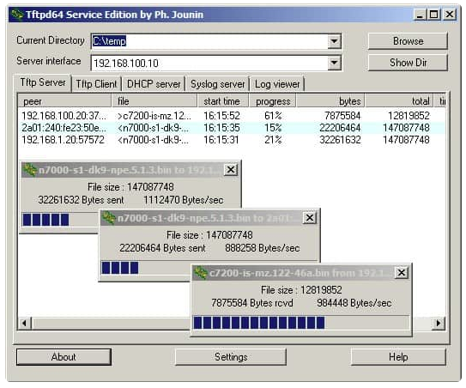
TFTPD64
Pros & cons
Pros:
Open-source tool, completely transparent
Has a simple interface that gets the job done and is easy to navigate
Offers a host of configurable options
Can track file transfers via log, or visually in real-time as they come in
Cons:
More complicate – has options for DNS, DHCP, and timeclock servers
Has a higher learning curve than other options

Slide 18
tftp
Hanewin tftp Server
The haneWIN TFTP server is a full-featured 32-bit and 64-bit TFTP server that runs on Windows XP/VISTA/20xx (servers)/7/8/10. It breaks from the TFTP model a bit by supporting access controls, which are not natively part of TFTP. This TFTP server can restrict IP addresses to only allow downloading or uploading and access to server directories.
Key features:
Command line option for scripts
Includes DHCP server
→ The haneWIN TFTP server is a slight improvement on the traditional TFTP server because it adds access control to its procedures and can restrict the IP addresses that it will deal with, which goes some way to reducing the risk of intruder manipulation of the file transfer process.

Slide 19
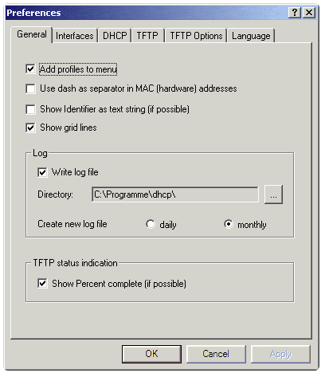
Hanewin tftp
Pros & cons
Pros:
Simple easy to learn interface
Lightweight installation, good for older hardware
Uniquely supports access controls for TFTP
Has a command-line interface for quick changes scripting
Cons:
Not as user-friendly as some other options
Higher learning curve due to more technical options/features

Slide 20
tftp
pinkie
Pinkie is a free Windows-based network monitoring toolset. The different tools in the utility are accessed through tabs at the top of the main dashboard panel of the user interface. This useful little bundle from IPUptime also includes a DNS server, Ping, and Traceroute. The Pinkie TFTP Server just listens. It will pick up any messages sent to its host on port 69.
Key features:
Includes DNS and network utilities
Lists recent transactions
→ Pinkie is a bundle of useful tools and in many ways, it is very similar to TFTPD64. Both of these systems are free and run on Windows. The main tool at the heart of Pinkie is its Ping implementation, which tests connection conditions. Unlike TFTPD64, there is no TFTP client in this package. However, its TFTP server is respectable and fuss-free.

Slide 21
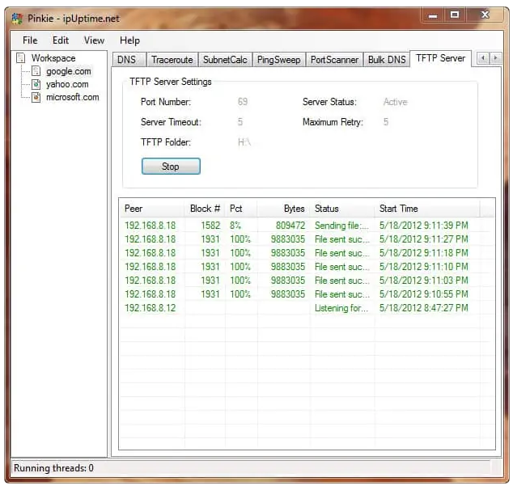
Pinkie
Pros & cons
Pros:
Lightweight tool takes up little space and resources
Organizes configurations by tabs, making them easy to find without cluttering the interface
Includes other features such as a DNS server, and options to run ping and traceroutes directly from the tool
Cons:
Could do better at listing recent transfers, can get cluttered with high volumes of transactions
Workspaces can be clunky to organize if you have a larger number of trading partners

Slide 22
references
Adam Woodbeck - Network Programming with Go_ Learn to Code Secure and Reliable Network Services from Scratch-No Starch Press (2021).
https://www.geeksforgeeks.org/what-is-tftp-trivial-file-transfer-protocol/
https://www.spiceworks.com/it-articles/what-is-tftp/#:~:text=As%20a%20Network%20Admin%2C%20you,User%20Data%20Protocol%20(UDP).
https://www.comparitech.com/net-admin/best-free-tftp-servers/

Slide 23
Thankyou

